Slide 1
Food Health & Safety
Training 2021

Slide 2
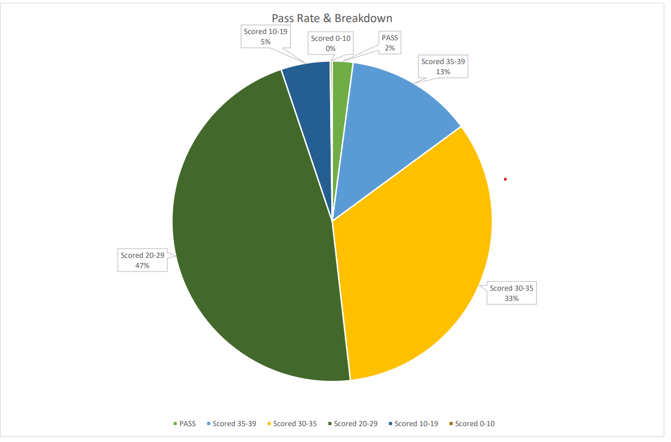
Pass Rate
47% scored under 30 (259)
Only 2% got 40/40
(11 People)
46% scored 30-39 (253)
We’ve now made a separate KP quiz

Slide 3
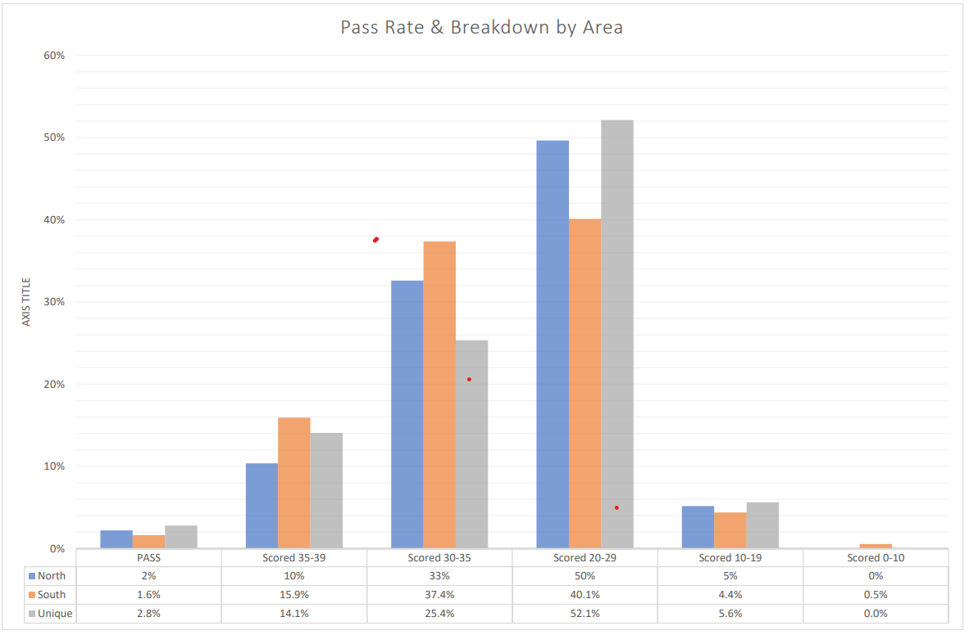
Pass Rate By Region

Slide 4
COSHH, Personal Hygiene Health & Safety
46% of staff didn’t know the safe temperature to drop fryer oil
Control of Substances
Hazardous to Health
Notes:
What does COSHH stand for?

Slide 5
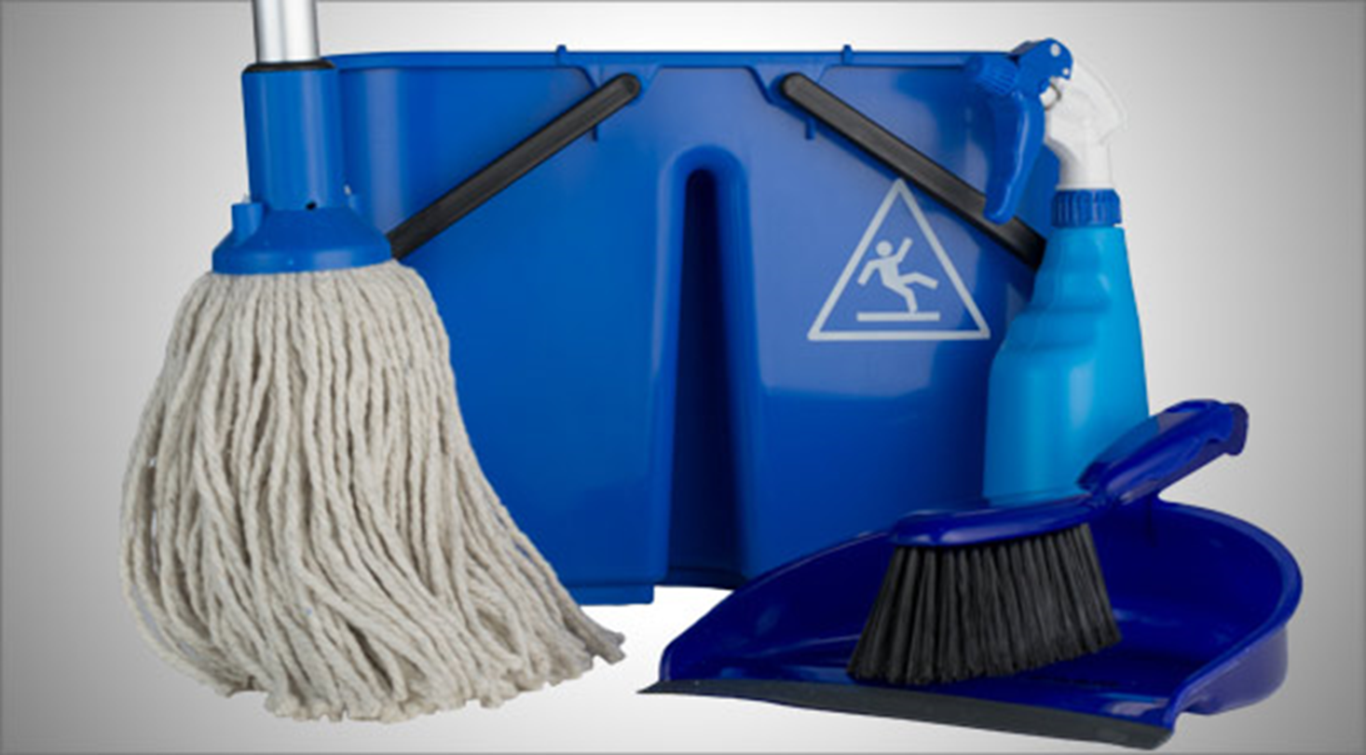
Cleaning Equipment Colour
Only Blue equipment should be used within the kitchens
Red for toilets and Yellow for FOH and Green for the bar
Notes:
What colour equipment should we use and why do we use different colours

Slide 6
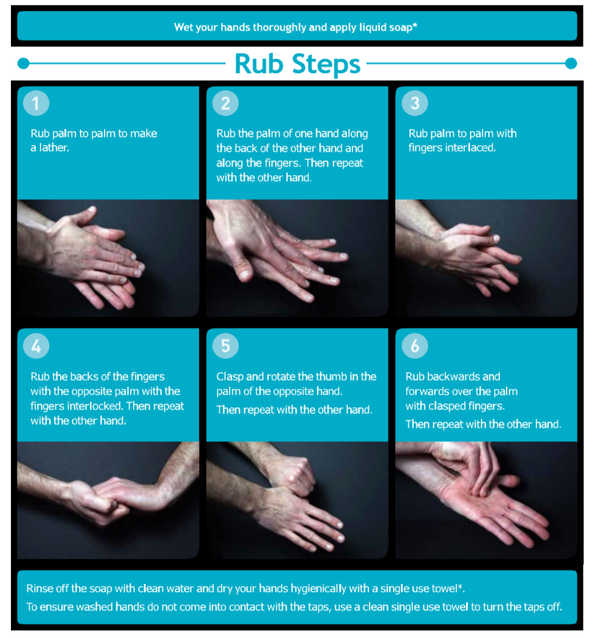
Hand washing time and type of soap
Hand washing should take 20 seconds (happy birthday twice)
Anti-Bacterial soap should be used
Hot water
Dry hands with blue roll
Notes:
How long should hand washing take?

Slide 7

Hand washing with Gordon

Slide 8
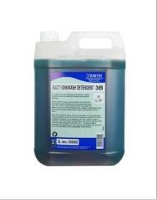
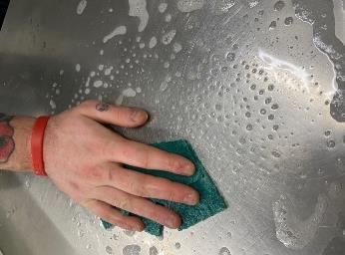
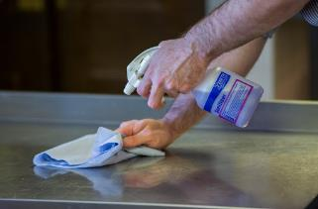
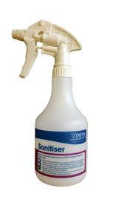
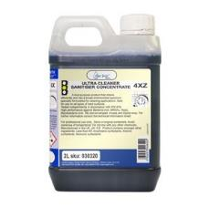
Contact Time & Two Stage Cleaning
1. Remove food Debris, wash surface with hot soapy water and dry with blue roll
2. Disinfect surface with sanitiser and leave for 30 Secs
3. Wipe away sanitiser with clean blue roll
We should clean down as frequently as needed and when chopping boards are dirty we should replace with fresh boards

Slide 9
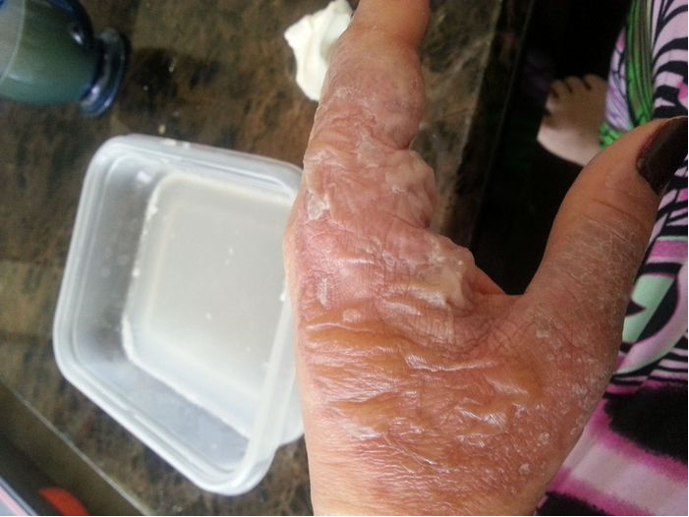
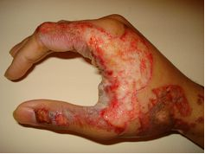

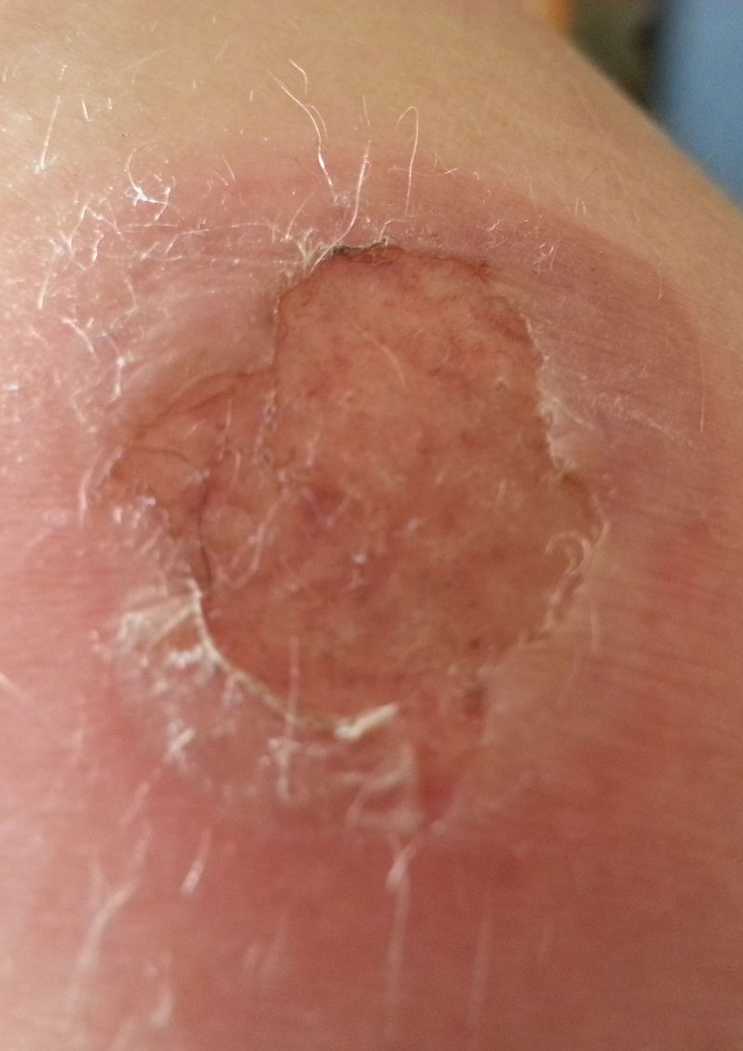
Fryer Cleaning Policy
0
Oil Temp MUST not be over 40c
Do NOT clean or wipe at end of shift
Do NOT drop the fryers whilst hot
Notes:
What Temperature shouldn’t we clean fryer above?

Slide 10

Notes:
What Temperature shouldn’t we clean fryer above?

Slide 11
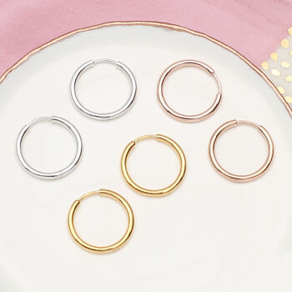

Jewellery
WEDDING RINGS
SLEEPER EARINGS
Notes:
What Jewellery can be worn within the kitchen?

Slide 12

Fitness To Work & Accidents
All instances of diarrhoea and vomiting MUST be reported
All skin conditions must be reported
Any infectious disease or infection must be reported including eye infections
A headache doesn’t need to be reported unless accompanied with other symptoms
All Accidents must be reported to line manager
Then recorded on southalls
Notes:
What illness should be reported and what don’t you need to report

Slide 13
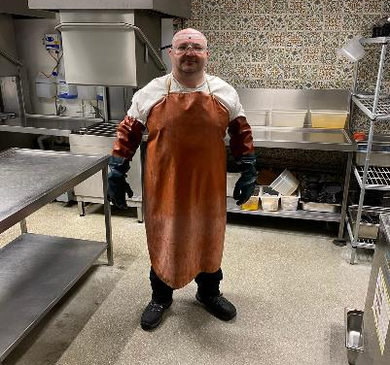
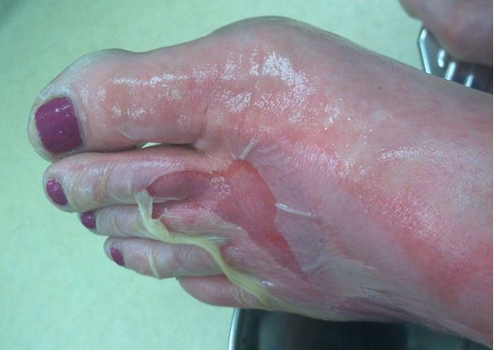
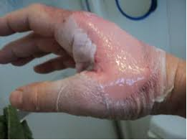
Why Do We Use Decarb & Decarb Safety
Safety Goggles (Zenith)
Red and Green Gauntlets (Email Vaclensa) CustomerService@vaclensa.com
Heavy Duty Apron (Zenith)
Training
The decarb is used to remove carbon not to remove SOP and grease from trays
If you don’t have any of this equipment the decarb MUST NOT BE USED
Incorrect shoes being worn
Gloves ripped or hand put in decarb above safe level
Notes:
Why do we use the decarb What items must you have to use the decarb and can it be used without ?

Slide 14
Allergens
66% of staff failed to answer the allergy questions correctly
That’s 363 people who could have caused a severe allergic reaction
14
Notes:
How many listed known allergens are there ?

Slide 15
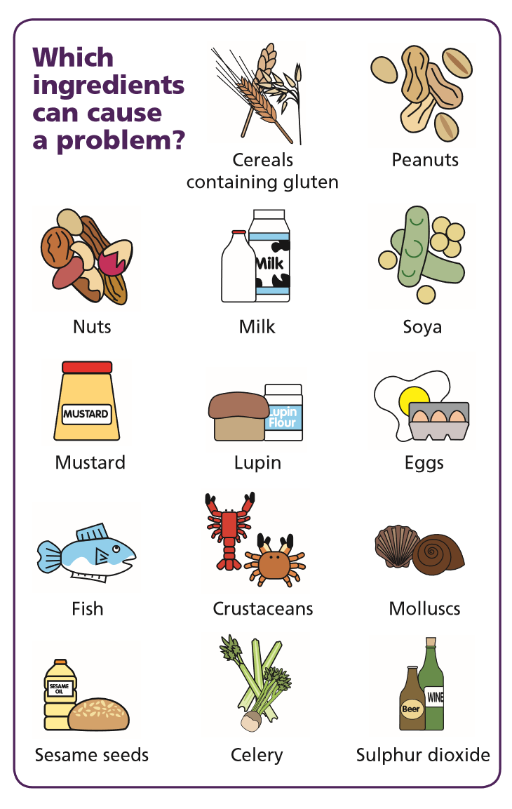
Known Allergens & Checklist
When an allergen check comes on what should we do?
Wash hands for 20 seconds
Check allergen matrix
Use fresh utensils and boards
Clean down and sanitise area
Make sure the whole team is aware of the allergen
Keep allergen dish separate throughout the cooking process
Call manager once food is ready

Slide 16
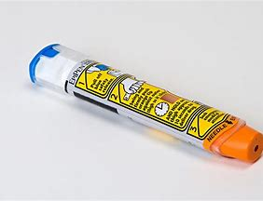
What is the difference between an allergen and intolerance
A food intolerance is generally less serious and often limited to digestion problems
An example being nausea, stomach pain, gas, heart burn and diarrhoea
A true allergy triggers an immune response which affects multiple organs, which can be life threatening
An example being Anaphylaxis shock, which causes swelling and tightness In the throat, chest pain and the need to carry an epi pen
It can take 5-30 mins for the symptoms to present themselves

Slide 17

Allergens
You could also face a man slaughter prison sentence
Failing to comply with allergy procedure could result in an unlimited fine for the individual involved
Averaging £20k
Below are the 14 allergens and common places they are found, but be sure you check the allergy matrix for every allergen check
Notes:
How many listed known allergens are there ?

Slide 18
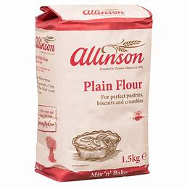
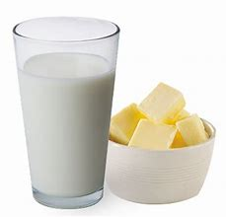
Gluten
What is it
Is a protein found in most grains
Where is it found
Flour, Bread, Baked goods and beer
Where can it be found on our menu
A few examples are baked camembert, calamari, fish & chips, burger buns ,bread and butter pudding, brownie
https://www.theguardian.com/world/2010/aug/18/italian-restaurant-death-gluten-ice-cream
Milk & Dairy
What is it
The allergy is caused when the body lacks the enzyme and ability to break down proteins found in cows milk, lactose and casein
Where is it found
Butter, cream, milk, cheese, ice cream, yoghurt
Where can it be found on our menu
A few examples are onion petals, scotch egg, buttermilk chicken burger, hot board, cookie dough, lemon tart
https://www.bbc.co.uk/news/uk-england-49675943
“Child dies from anaphylactic shock after eating ice cream containing biscuits”
“18 yr old dies after eating ‘grilled chicken’ burger. There was no mention of the dairy marinade”

Slide 19
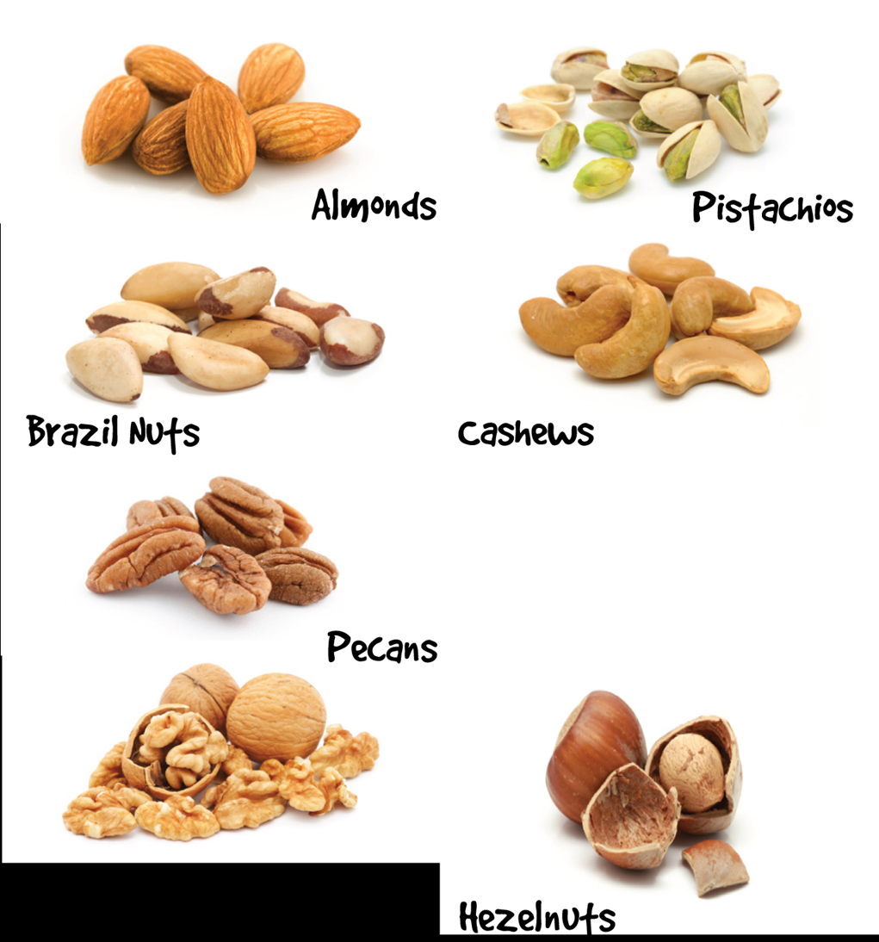
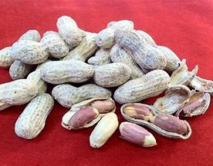
Peanuts (monkey nut)
What is it
Are legumes that grow underground
Where is it found
Pesto, cereal, baked goods, some medications
Where can it be found on our menu
A few examples are peanut butter cup and kids banana split
https://www.independent.co.uk/news/uk/crime/indian-restaurant-owner-mohammed-zaman-jailed-six-years-killing-customer-curry-a7043596.html
Nuts
What is it
Grows in a hard shell on trees including:
Walnuts, pistachios, pecans, macadamia, brazil nuts, cashew, almonds
Where is it found
Baked goods, alcohol, salad dressings and veggie substitutes
Where can it be found on our menu
A few examples are tenderstem broccoli (almonds) , bread and butter pudding (hazelnuts), pistachio ice cream. (a large part of our menu has may contain nuts on allergy matrix be sure to check)
“Restaurant owner jailed for 6 years, after killing some by serving a curry which contained nut paste ”

Slide 20

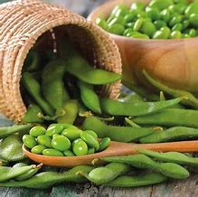
Soya
What is it
A product of soya beans, which is legume native to East Asia
Where is it found
Soya Beans, energy bars, miso, tofu, canned tuna, some breads
Where can it be found on our menu
A few examples are celeriac soup, cheesy garlic bread, seabass, steak pie, mac n cheese, all our kebabs and sweet chilli chips
Lupin
What is it
A plant or legume which belongs to same family as a peanut
Where is it found
Some shop bought Pasta, houmous, biscuits and also olives, some ice creams
Where can it be found on our menu
Currently not found on our menu

Slide 21
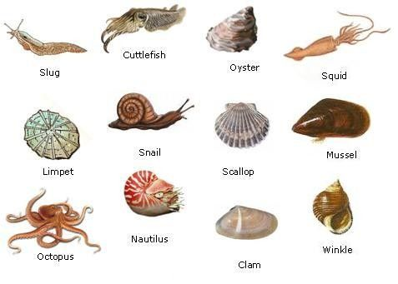
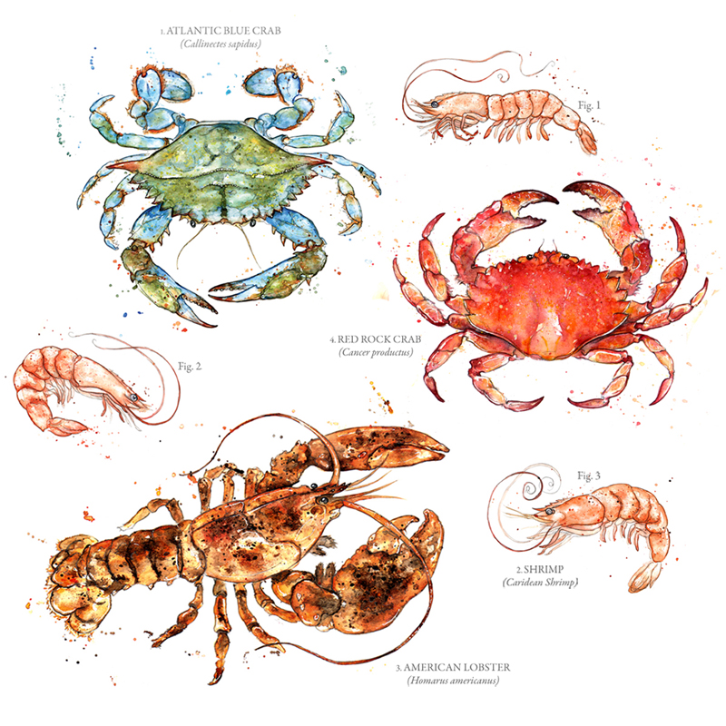
Crustacean
What is it
An aquatic arthropod which has a hard shell with legs, the allergy is caused by a protein call tropomyosin
Where is it found
Prawns, crab, lobster, langoustine
Where can it be found on our menu
A few examples are garlic deli prawns, kids scampi
Mollusc
What is it
An animal which has a soft body and no shell with no legs but some have tentacles
Where is it found
Oysters, snails, mussels, clams, cuttlefish, octopus
Where can it be found on our menu
Calamari

Slide 22
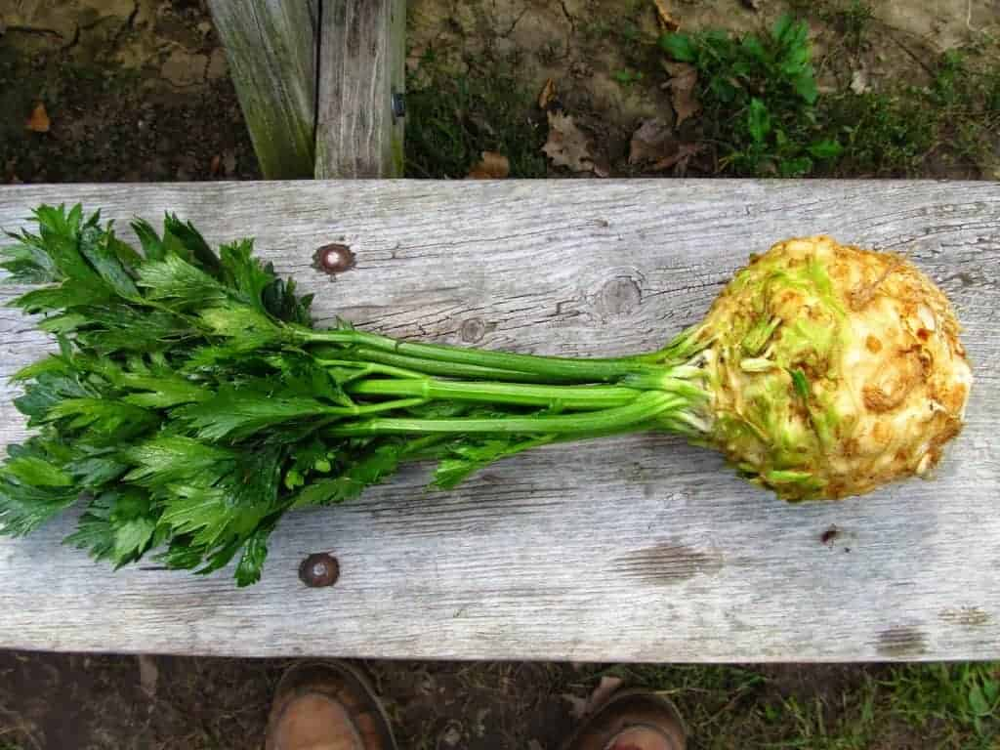
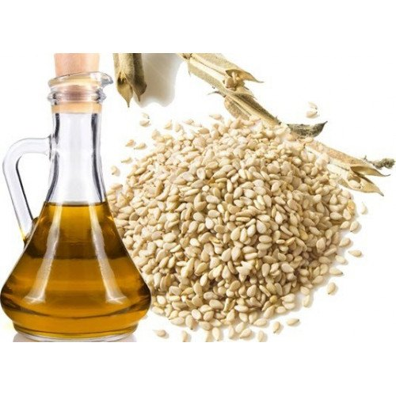
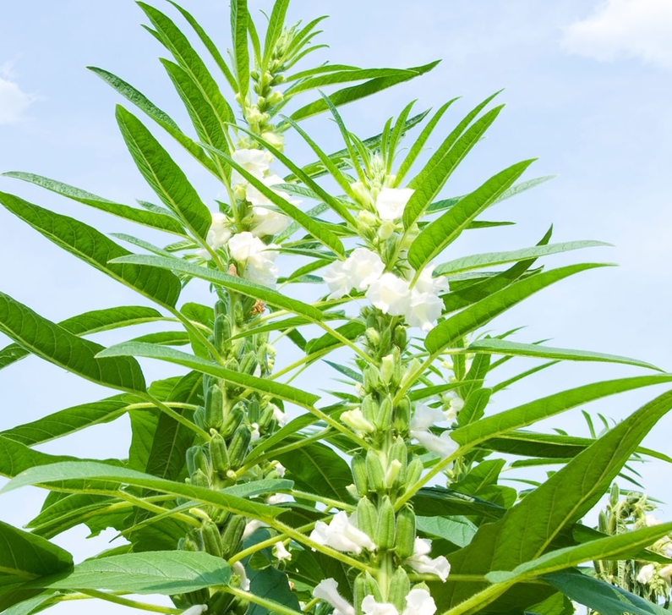
Celery
What is it
Long fibrous stalks and bulbous root vegetable native to the Mediterranean
Where is it found
Celery, celeriac, juices, celery salt, Heinz ketchup, bbq sauce
Where can it be found on our menu
A few examples are celeriac soup, vegan gravy, steak pie
Sesame
What is it
A flowering plant cultivated for its seeds native to Africa
Where is it found
Asian dishes, cereals, burger buns, bagels, bread sticks, sesame oil, sesame seeds, tahini
Where can it be found on our menu
A few examples are pork crackling, houmous, winter kale salad, all burgers, sweet chilli chips

Slide 23
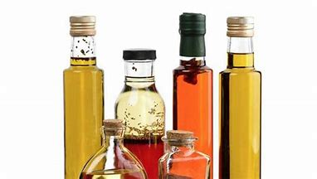
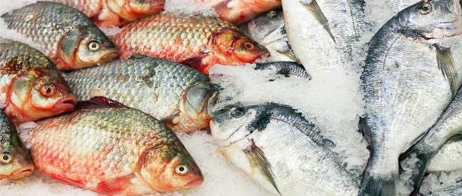
Sulphites
What is it
Naturally occurring chemical compounds found in all types of wine. Added to food for food enhancement and preservatives
Where is it found
Wine, vinegar, dried fruit and sauerkraut
Where can it be found on our menu
A few examples are cauliflower wings, salt and pepper wings, fish and chips, curry, house salad
Fish
What is it
Caused by an allergic reaction to the specific proteins found in the fish flesh called parvalbumin, more prominent in muscle tissue of white fish
Where is it found
Fish, Worcestershire sauce, Caesar salad dressing
Where can it be found on our menu
A few examples are calamari,fish and chips, seabass

Slide 24
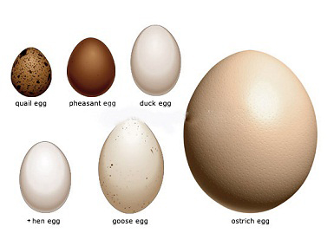
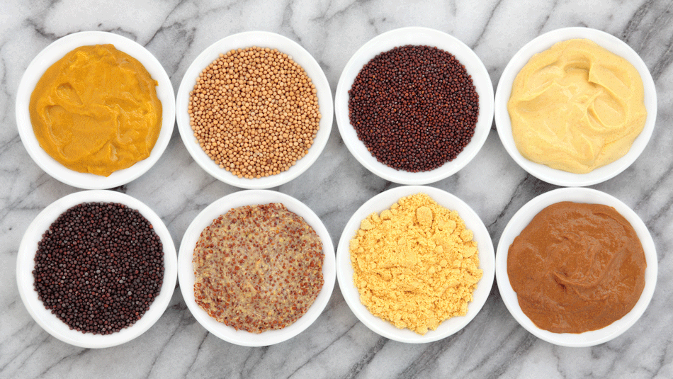

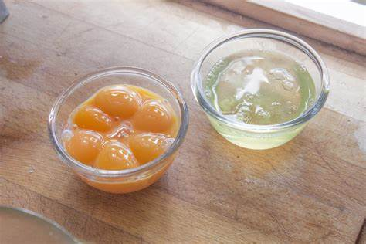
Eggs
What is it
The allergy is caused by an immune hypersensitivity to proteins found within the egg whites called ovalbumin
Where is it found
Eggs, mayonnaise, meringue, eggnog, baked goods, desserts
Where can it be found on our menu
A few examples are breakfast, scotch egg, fish and chips, lemon tart and cookie dough
Mustard
What is it
A condiment made from the seed of a mustard plant, the allergy is caused by an enzyme that cannot break down in digestive tract
Where is it found
Mustard, mayonnaise, bbq sauce, ketchup, piccalilli
Where can it be found on our menu
A few examples are halloumi burger, mac n cheese, red cabbage slaw

Slide 25
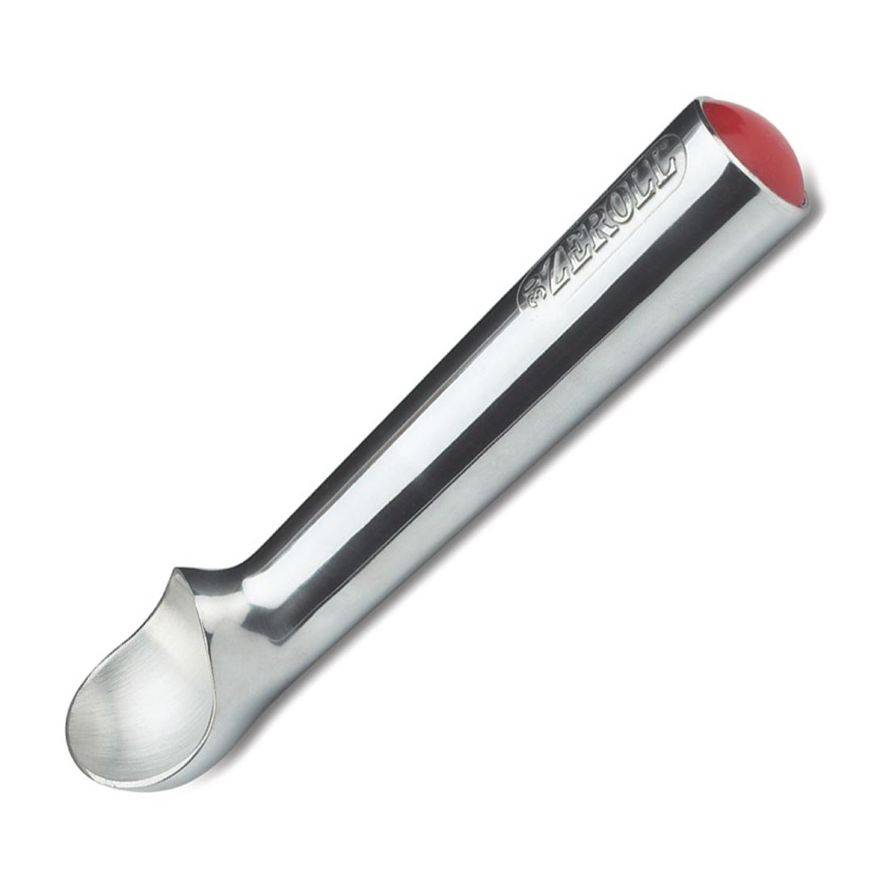
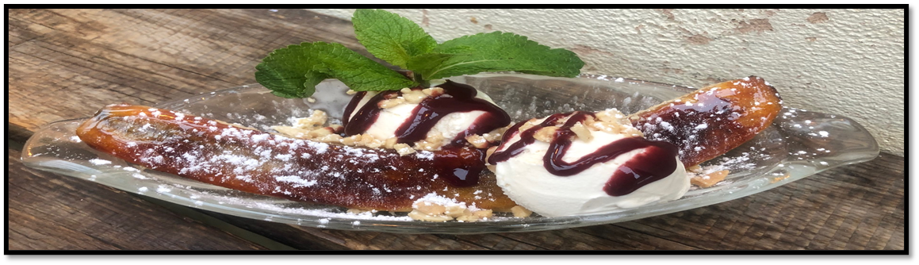
Ice Cream Scoops
We Must have two scoops stored separately, labelled in clean hot water
This is to avoid cross contamination between dairy and non dairy products
We should always wash the utensils if we have an allergen check
“Boy died of violent allergic reaction after waiter served wrong type of ice cream”
Dairy
Within 4 months we have had 2 incidents within our sites where the incorrect ice cream has been served
Non-Dairy
These are both caused by lack of training and understanding
NON DAIRY ICE CREAM
Notes:
Why do we store ice cream scoops separately and what ice cream is in our kids banana split

Slide 26
Food Safety
33% of staff didn’t know the danger zone
44% of staff don’t know how to store tongs safely
33% of staff don’t understand grill mapping
36% of staff don’t know where to store eggs

Slide 27
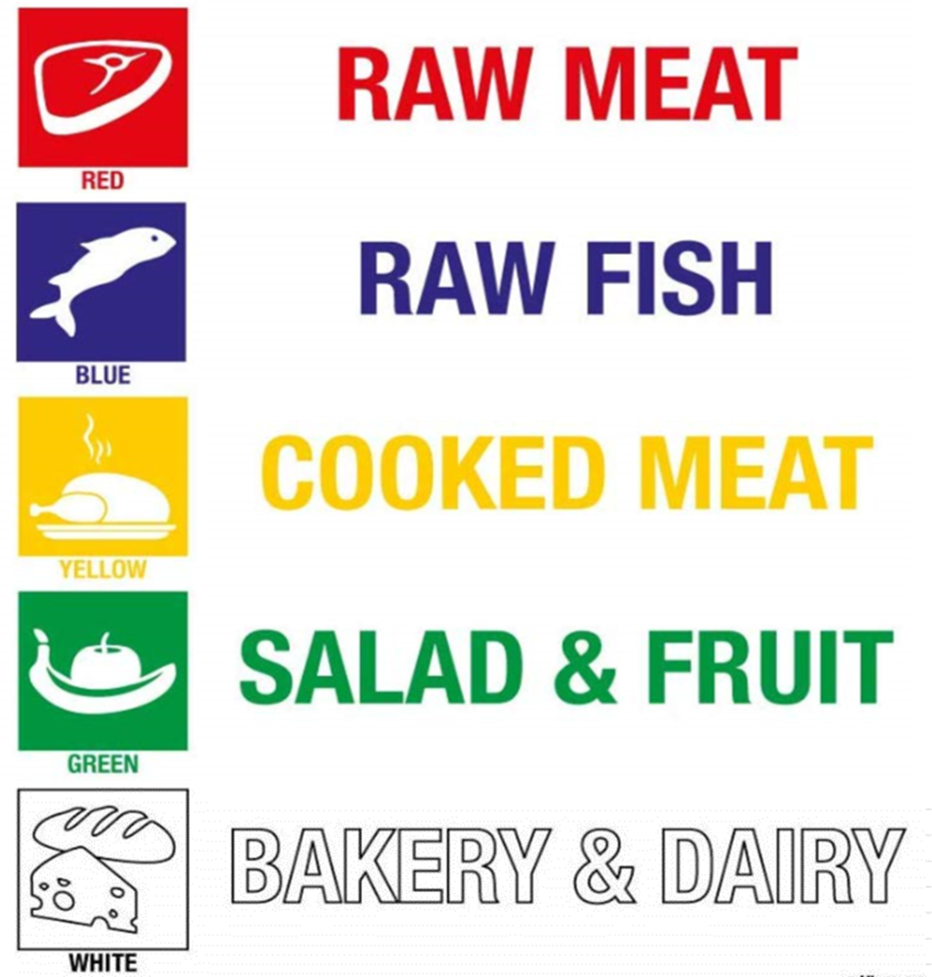
Chopping Board Guide & Storage
Chopping boards MUST be stored in a rack allowing space between them
Red and Blue boards must be stored separately in the raw prep area to avoid cross contamination
&VEG

Slide 28
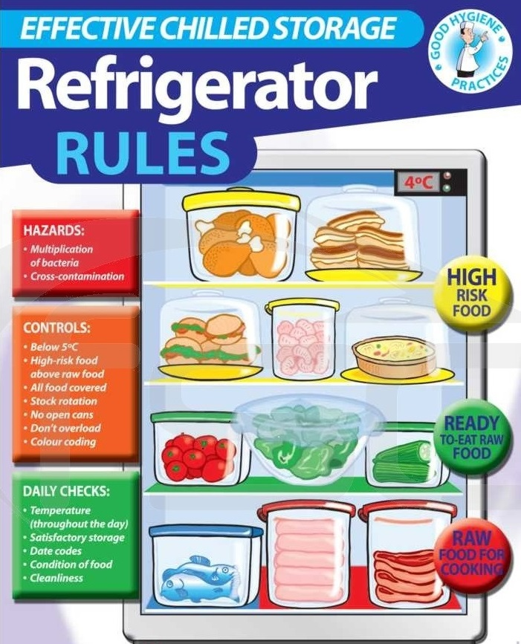
Food Storage, cured meat, fish and eggs
Cooked ready to eat products
Bread, Dairy, Cooked Meats, Cooked Fish
Vegetables
Vegetables and salads, dirty root veg below or separate to salad items
Raw Meat, Raw Fish, Eggs
Bottom shelf should be reserved for raw proteins
NO FOOD PRODUCTS TO BE STORED ON FLOOR EVEN IN DRY STORE

Slide 29
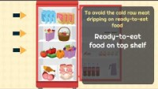
Food Storage

Slide 30
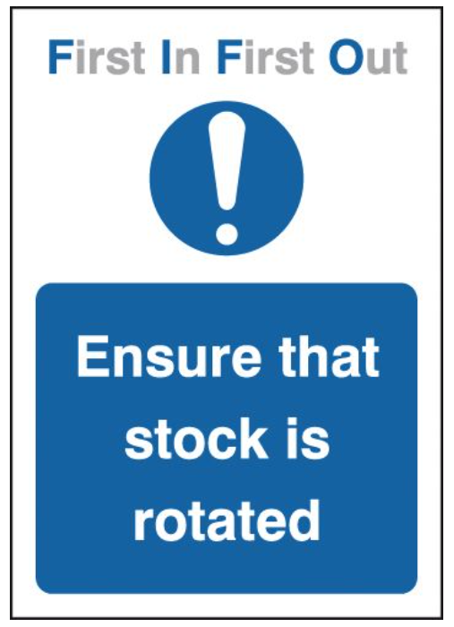
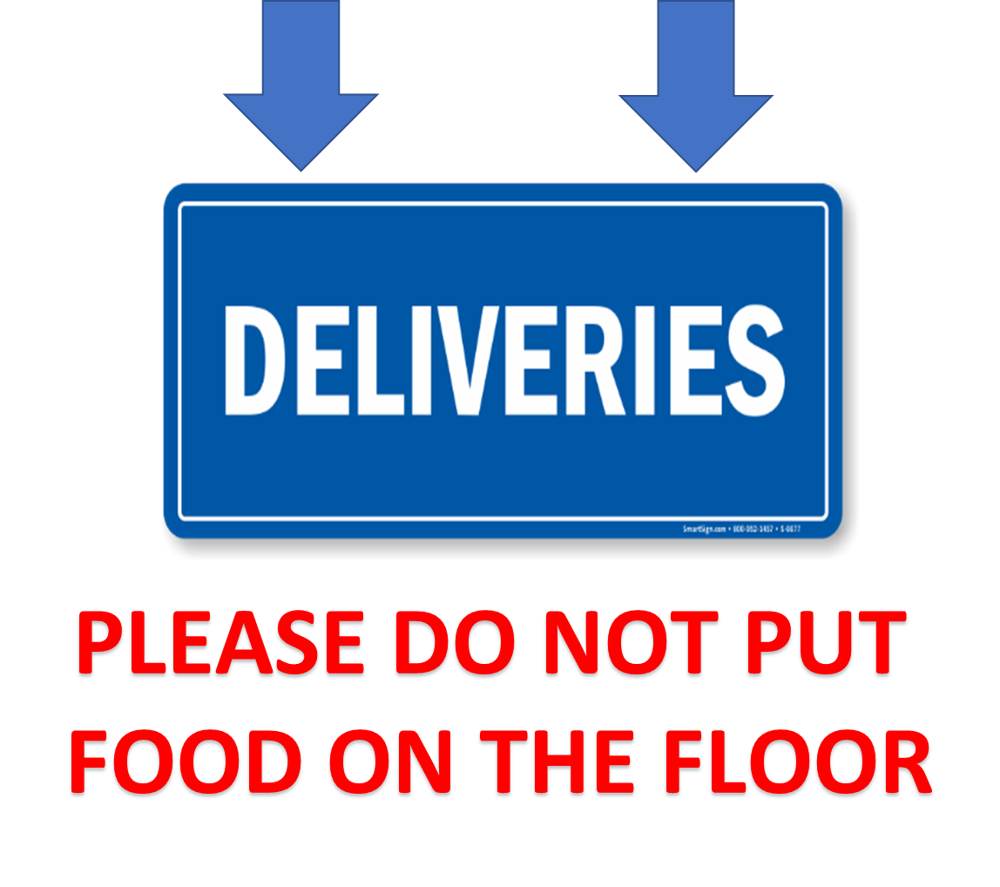
FIFO & Deliveries
FIFO helps to ensure stock is correctly rotated and reduces waste
All deliveries should be put in the designated drop zone
This should be labelled with this poster
Deliveries should be put away within 15 minutes and recorded on trail

Slide 31
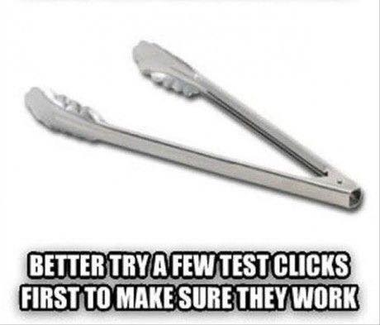
Tongs Storage
Tongs should be stored in clean HOT water.
They shouldn’t be stored in sanitizer to avoid cross contamination to food
Separate tongs should be used for RAW, COOKED & PLATING

Slide 32
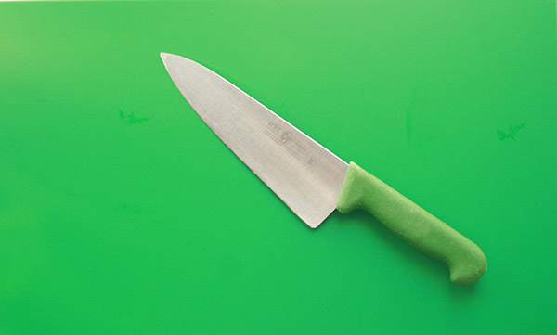
Veg Preparation For Kebabs
Veg For kebabs should be washed in FOOD PREP SINK
And then prepared in a clean prep area on a clean green chopping board using a green knife
DO NOT PREPARE IN RAW MEAT AND FISH SECTION

Slide 33
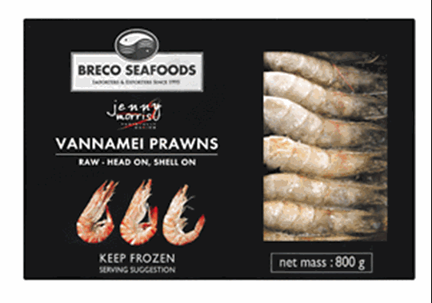
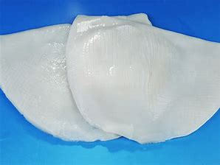
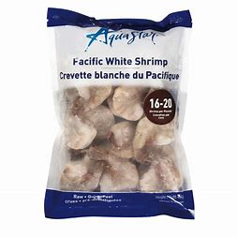
Defrost Policy
Best Practice:
Defrosting of a frozen food product should take place in high sided container
In a fridge overnight and defrost temp recorded on trail when fully defrosted
Ensure item is labelled when removed from the freezer
EMERGENCY Frozen calamari and prawns can be defrosted in prep sink under RUNNING COLD water for maximum of 2 hours

Slide 34
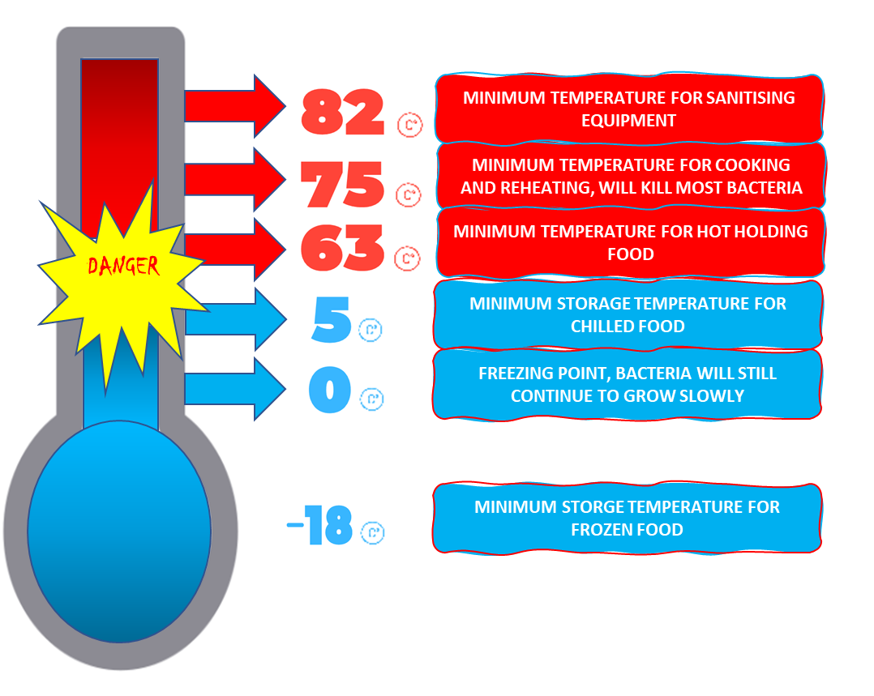
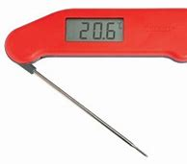
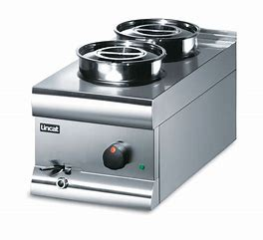
Food Safety Temperatures
Danger Zone 5c-63c
---- Between these temperatures it is the prime temperature for bacterial growth
Minimum Cooking and Reheating temperature
75.0
5-63
Minimum Hot Hold Temperature 63c
Fridge Temp Range between 1c-5c
Freezer Storage below -18
If units are not running between these temps please call an engineer, and move food if not spoilt to other unit

Slide 35
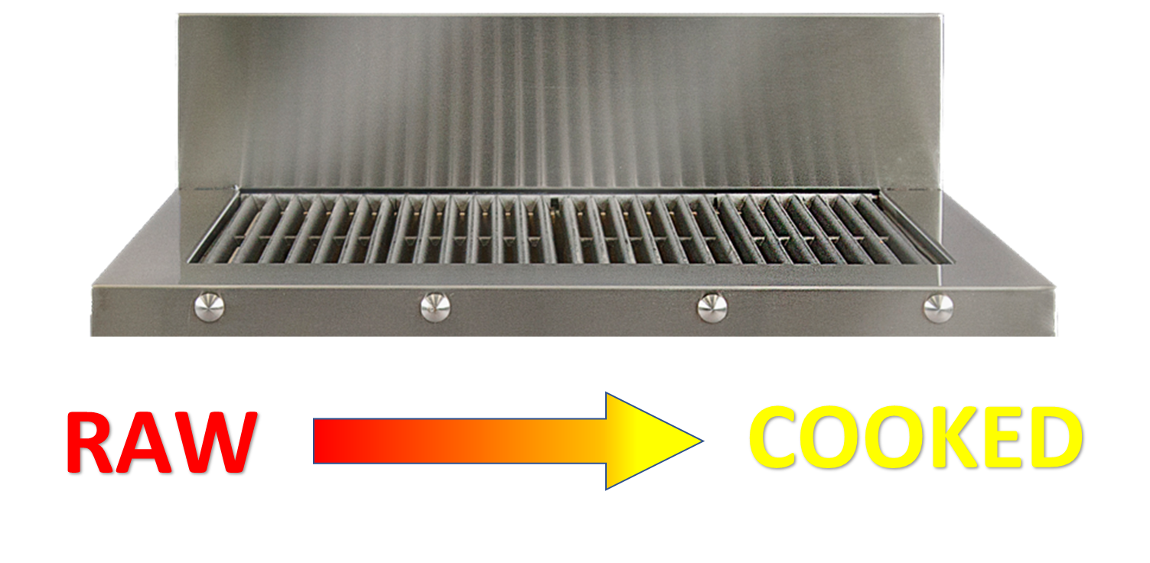
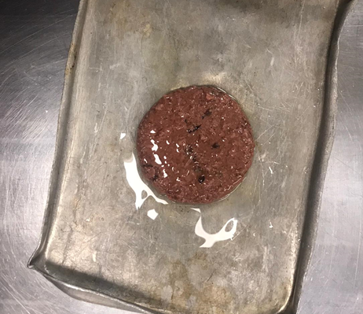

Grill Mapping & Vegan Products
To avoid cross contamination
Raw meat should be placed on the left hand side of the grill and moved to the right during cooking
Unless doing prep on clean a grill
Vegan Items should NEVER be cooked on the chargrill

Slide 36




What is Best Practice for Chilling Prepared Food?
Break down large batches into smaller containers
Using large gastro fill with ice water and submerge containers
Must be chilled to below 8c within 90 minutes
Food can be placed into fridge once at ambient temperature below (20c)
Record item on trail
Blast Chiller to be used in sites where applicable

Slide 37

Freezer and dry store labelling policy
All frozen items to be labelled 1 month and signed off by head chef
Dry Store items should be stored and labelled following manufactures guidelines

Slide 38

You Have Now Received Health & Safety Training

Slide 39

You can find the test on our new portal
https://www.newworldchefs.online/academy
GOOD LUCK!!

